Slide 1
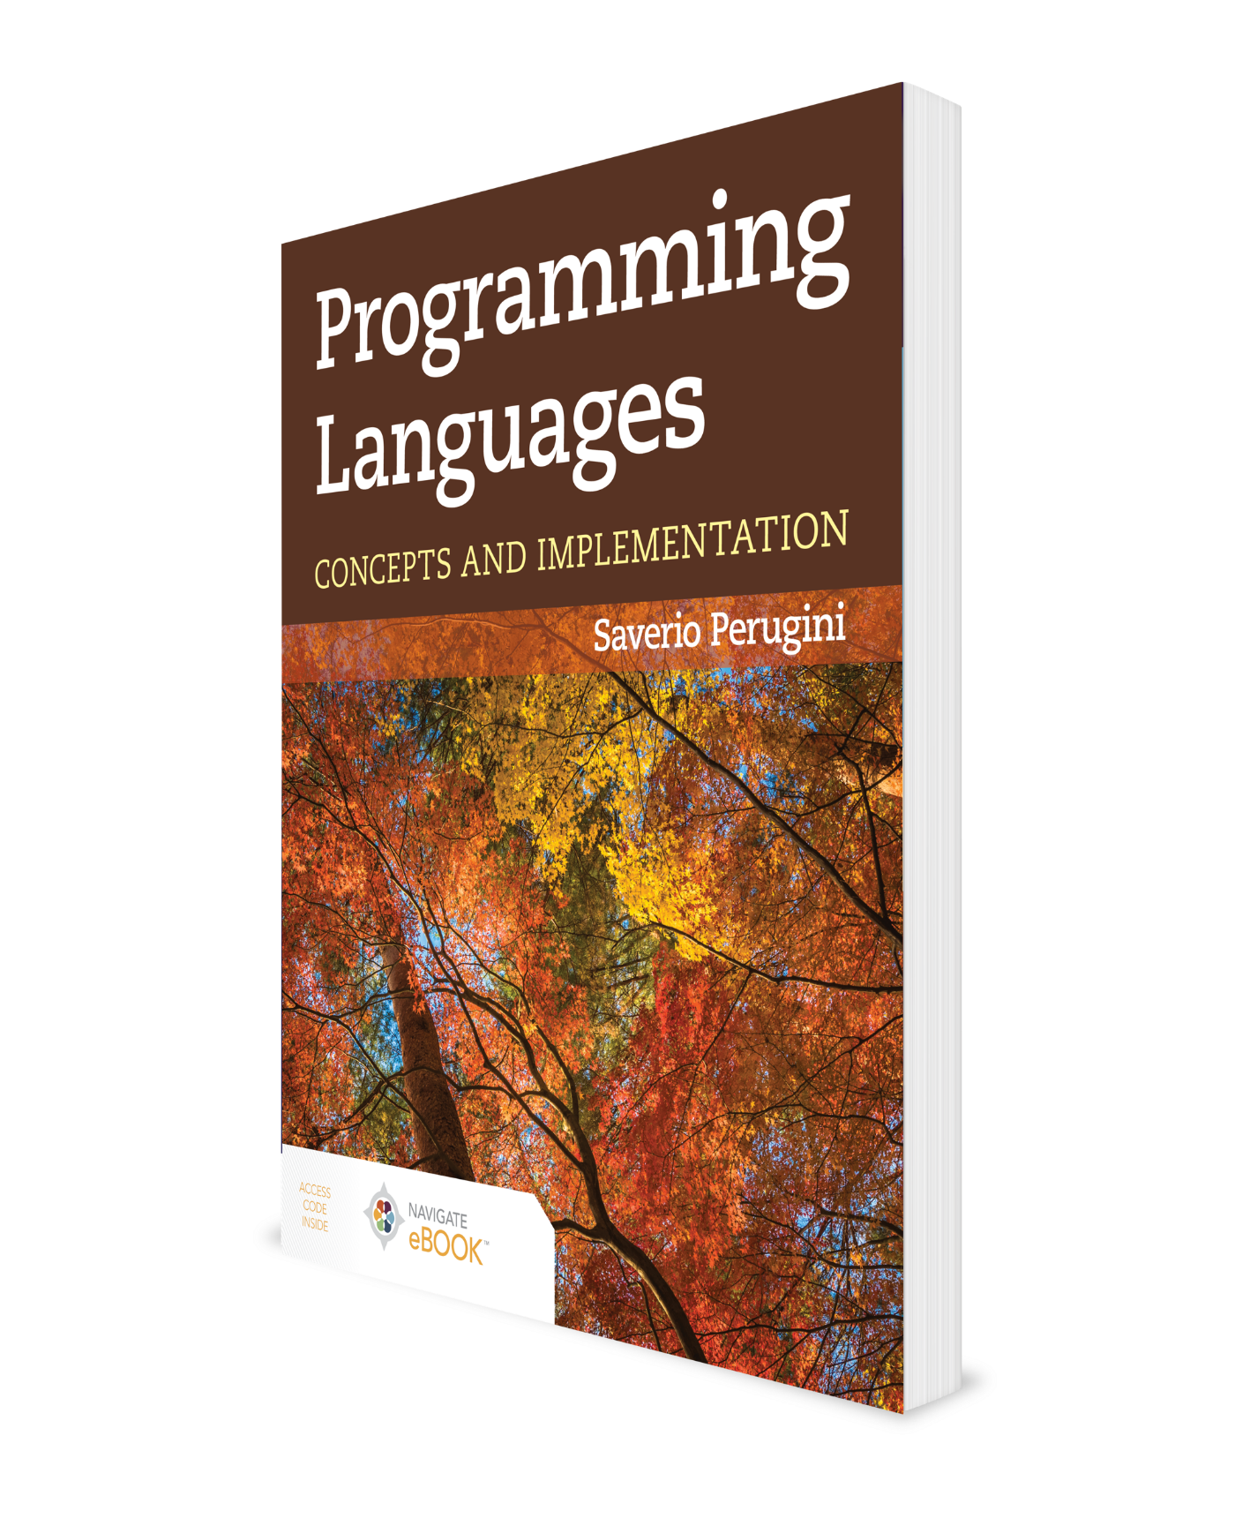
Binding and Scope
CHAPTER 6

Slide 2
Chapter 6: Binding and Scope
A rose by any other name would smell as sweet.
— William Shakespeare

Slide 3
6.1 Chapter Objectives
Describe first-class closures.
Understand the meaning of the adjectives static and dynamic in the context of programming languages.
Discuss scope as a type of binding from variable reference to declaration.
Differentiate between static and dynamic scoping.
Discuss the relationship between the lexical layout of a program and the representation and structure of a referencing environment for that program.
Define lexical addressing and consider how it obviates the need for identifiers in a program.
Discuss program translation as a means of improving the efficiency of execution.
Learn how to resolve references in functions to parts of the program not currently executing (i.e., the funarg problem).
Understand the difference between deep, shallow, and ad hoc binding in passing first-class functions as arguments to procedures.

Slide 4
6.2.1 What Is a Closure?
A closure is a function that remembers the lexical environment in which it was created.
A closure can be thought of as a pair of pointers:
One to a block of code (defining the function)
One to an environment (in which function was created).
The bindings in the environment are used to evaluate the expressions in the code.
A closure encapsulates data and operations and, thus, bears a resemblance to an object as used in object-oriented programming.
Closures are powerful constructs in functional programming, and an essential element in the study of binding and scope.

Slide 5
6.2.2 Static Vis-à-Vis Dynamic Bindings
Table 6.1 Static Vis-à-Vis Dynamic Bindings

Slide 6
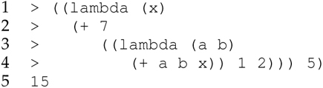
6.3 Introduction (1 of 2)
Variables appear as either references or declarations.
The value named by a variable is called its denotation.
The denotations of x, a, and b are 5, 1, and 2, respectively.
The x on line 1 and the a and b on line 3 are declarations, while the a, b, and x on line 4 are references.
A reference to a variable (e.g., the a on line 4) is bound to a declaration of a variable (e.g., the a on line 3).

Slide 7
6.3 Introduction (2 of 2)
Declarations have limited scope.
The scope of a variable declaration in a program is the region of that program (i.e., a range of lines of code) within which references to that variable refer to the declaration (Friedman, Wand, and Haynes 2001).
The scope of the declaration of a in the preceding example is line 4—the same as for b. The scope of the declaration of x is lines 2–4.
The scope rules of a programming language indicate to which declaration a reference is bound.
Languages where that binding can be determined by examining the text of the program before run-time use static scoping.
Languages where the determination of that binding requires information available at runtime use dynamic scoping.

Slide 8
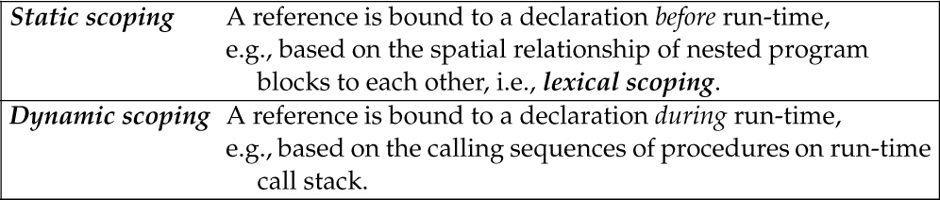
Table 6.2 Static Scoping Vis-à-Vis Dynamic Scoping

Slide 9
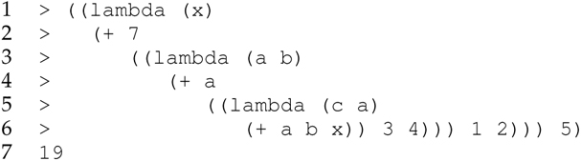
6.4.1 Lexical Scoping
This entire expression (lines 1–6) is a block, which contains a nested block (lines 2–6), which itself contains another block (lines 3–6), and so on.
Lines 5–6 are the innermost block and lines 1–6 constitute the outermost block; lines 3–6 make up an intervening block.

Slide 10
Lexical Scoping Procedure
Start with the innermost block of the expression containing the reference and search within it for its declaration.
If it is not found there, search the next block enclosing the one just searched. If the declaration is not found there, continue searching in this innermost-to-outermost fashion until a declaration is found.
After searching the outermost block, if a declaration is not found, the variable reference is free (as opposed to bound).
Due to the scope rules of Scheme and the lexical layout of the program that it relies upon, reveals that the reference to x in line 6 of the example Scheme expression previously is bound to the declaration of x on line 1.
Neither the scope rule nor the procedure yields the scope of a declaration.

Slide 11
Shadow, Scope Hole, and Visibility
The scope of a declaration is the region of the program within which references refer to the declaration. In this example, the scope of the declaration of x is lines 2–6.
The scope of the declaration of a on line 3, by contrast, is lines 4–5 rather than lines 4–6, because the inner declaration of a on line 5 shadows the outer declaration of a on line 3.
The inner declaration of a on line 5 creates a scope hole on line 6, so that the scope of the declaration of a on line 3 is lines 4–5 and not lines 4–6.
The visibility of a declaration in a program constitutes the regions of that program where references are bound to that declaration—this is the definition of scope given and used previously.
Scope refers to the entire block of the program where the declaration is applicable.
Thus, the scope of a declaration includes scope holes since the bindings still exist but are hidden.
The visibility of a declaration is a subset of the scope of that declaration and, therefore, is bounded by the scope.

Slide 12
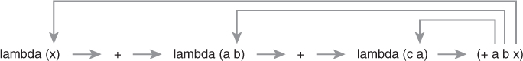
Nesting of blocks progresses from left to right. On line 2, the declaration of a on line 3 is not in scope:

Slide 13
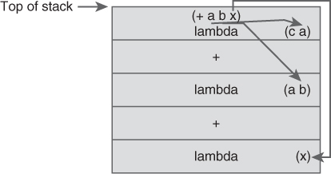
Figure 6.1 Run-time Call Stack at the Time the Expression (+ a b x) Is Evaluated
The arrows indicate to which declarations the references to a, b, and x are bound.

Slide 14
6.4.1 Lexical Scoping (Local Vis-à-Vis Nonlocal References) (1 of 2)
A reference can either be local or nonlocal.
A local reference is bound to a declaration in the set of declarations (e.g., the formal parameter list) associated with the innermost block in which that reference is contained.
Sometimes that block is called the local block.
All of the nested blocks enclosing the innermost block containing the reference are sometimes referred to as ancestor blocks of that block.
In a lexically scoped language, we search both the local and ancestor blocks to find the declaration to which a reference is bound.

Slide 15
6.4.1 Lexical Scoping (Local Vis-à-Vis Nonlocal References) (2 of 2)
We must determine the declaration to which a reference is bound so that we can determine the value bound to the identifier at that reference so that we can evaluate the expression containing that reference.
The concept of an environment, which is a core element of any interpreter:
A set or mapping of name–value pairs that associates variable names (or symbols) with their current bindings

Slide 16
6.5 Lexical Addressing (1 of 4)
Identifiers are necessary for writing programs, but unnecessary for executing them.
Assume we number the innermost-to-outermost blocks of an expression from 0 to n.
Lexical depth is an integer representing a block with respect to all of the nested blocks it contains.
Assume that we number each formal parameter in the declaration list associated with each block from 0 to m.
The declaration position of a particular identifier is an integer representing the position in the list of identifiers of a lambda expression of that identifier.

Slide 17
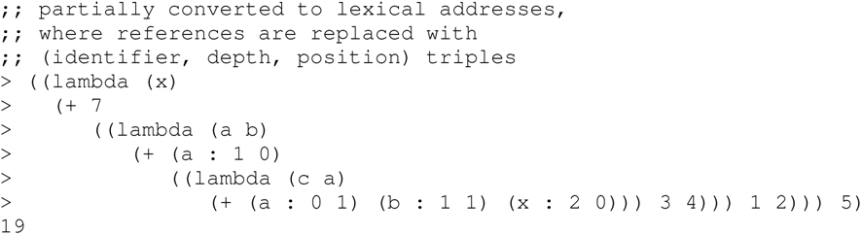
6.5 Lexical Addressing (2 of 4)
Given only a lexical address (i.e., lexical depth and declaration position), we can (efficiently) lookup the binding associated with the identifier in a reference.
We can purge the identifiers from each lexical address.

Slide 18
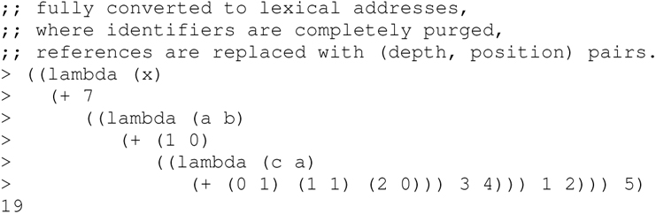
6.5 Lexical Addressing (3 of 4)

Slide 19
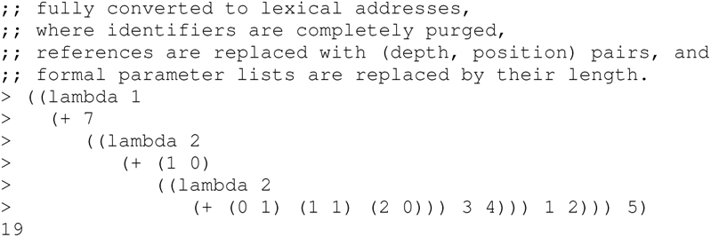
6.5 Lexical Addressing (4 of 4)
The formal parameter lists following each lambda are also unnecessary and, therefore, can be replaced with their length:

Slide 20
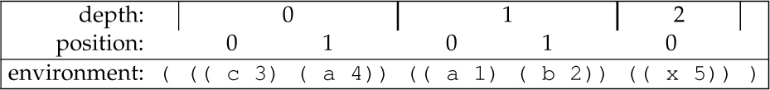
Table 6.3 Lexical Depth and Position in a Referencing Environment
How does this map to a list-based data structure?

Slide 21
6.6 Free or Bound Variables (1 of 2)
A variable v occurs free in an expression e if and only if there is a reference to v within e that is not bound by any declaration of v within e.
A variable v occurs bound in an expression e if and only if there is a reference to v within e that is bound by some declaration of v in e.
In the expression ((lambda (x) x) y)
The x in the body of the lambda expression occurs bound to the declaration of x in the formal parameter list.
The argument y occurs free because it is unbound by any declaration in this expression.

Slide 22
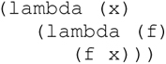
6.6 Free or Bound Variables (2 of 2)
The semantics of an expression without any free variables is fixed.
Consider the identity function (lambda (x) x). It has no free variables and its meaning is always fixed as “return the value that is passed to it.”
The semantics of the following expression, which also has no free variables, is always:
“a function that accepts a value x and returns ‘a function that accepts a function f and returns the result of applying the function f to the value x.”’

Slide 23
Outline
6.1 Chapter Objectives
6.2 Preliminaries
6.3 Introduction
6.4 Static Scoping
6.5 Lexical Addressing
6.6 Free or Bound Variables
6.7 Dynamic Scoping
6.8 Comparison of Static and Dynamic Scoping
6.9 Mixing Lexically and Dynamically Scoped Variables
6.10 The Funarg Problem
6.11 Deep, Shallow, and Ad Hoc Binding
6.12 Thematic Takeaways

Slide 24
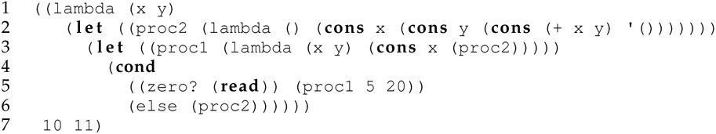
6.7 Dynamic Scoping (1 of 2)
We see nonlocal references to x and y in the definition of proc2 on line 2, which does not provide declarations for x and y.
To resolve those references so that we can evaluate the cons expression, we must determine to which declarations the references to x and y are bound.

Slide 25
6.7 Dynamic Scoping (2 of 2)
While static scoping involves a search of the program text, dynamic scoping involves a search of the run-time call stack.
Concept of static call graph
Indicates which procedures have access to each other (Figure 6.2)
Concept of the call chain (or dynamic call graph) of an expression
Depicts the series of functions called by the program as they would appear on the run-time call stack

Slide 26
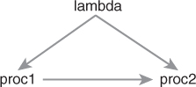
Figure 6.2 Static Call Graph of the Program Used to Illustrate Dynamic Scoping in Section 6.7

Slide 27
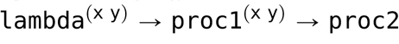
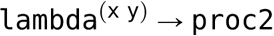
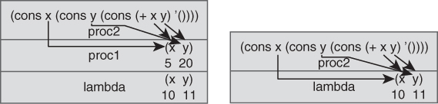
Figure 6.3 The Two Run-Time Call Stacks Possible from the Program Used to Illustrate Dynamic Scoping in Section 6.7
The stack on the left corresponds to call chain .
The stack on the right corresponds to call chain .

Slide 28
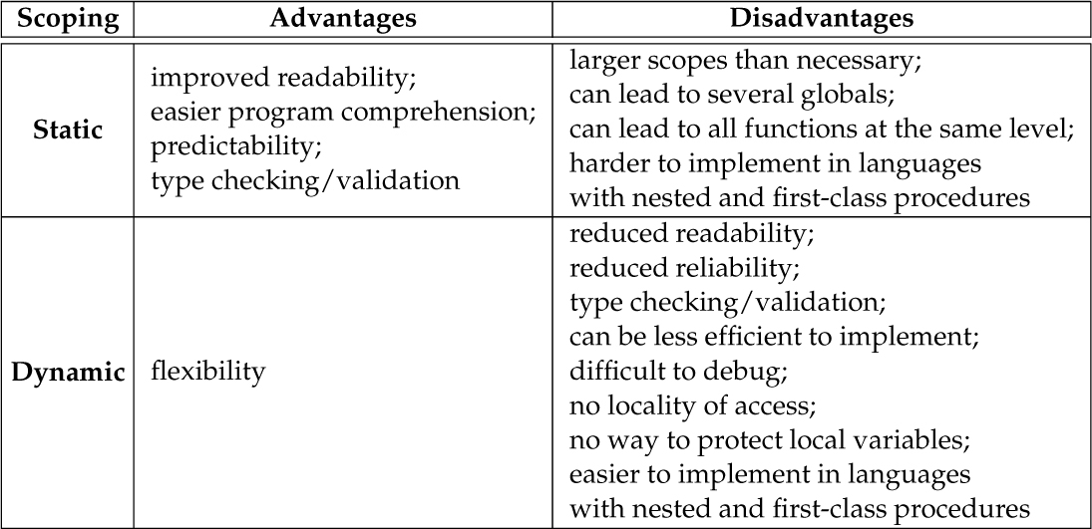
Table 6.5 Advantages and Disadvantages of Static and Dynamic Scoping

Slide 29
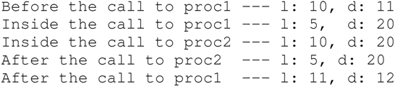
Listing 6.2 A Perl Program Demonstrating Dynamic Scoping
The output of this program is:
We need not run the program to determine to which declaration the reference to d on line 37 is bound.
We can determine the call chain of the procedures, before run-time, by examining the text of the program.
In most programs we cannot determine the call chain of procedure before run-time—primarily due to run-time input.

Slide 30
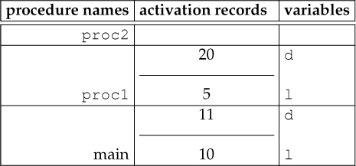
Figure 6.4 Depiction of Run-Time Stack at Call to print on Line 37 of Listing 6.2

Slide 31
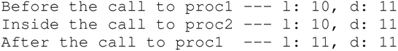
Listing 6.3 A Perl Program, Whose Run-Time Call Chain Depends on Its Input, Demonstrating Dynamic Scoping
The call chain depends on program input.
If the input is 5, then the call chain is
and the output is the same as the output for Listing 6.2.
Otherwise, the call chain is
and the output is:

Slide 32
Outline
6.1 Chapter Objectives
6.2 Preliminaries
6.3 Introduction
6.4 Static Scoping
6.5 Lexical Addressing
6.6 Free or Bound Variables
6.7 Dynamic Scoping
6.8 Comparison of Static and Dynamic Scoping
6.9 Mixing Lexically and Dynamically Scoped Variables
6.10 The Funarg Problem
6.11 Deep, Shallow, and Ad Hoc Binding
6.12 Thematic Takeaways

Slide 33
6.10 The Funarg Problem
With first-class procedures in the discussion of scope, resolving nonlocal references suddenly becomes more complex.
The question is: To which declaration does a reference in the body of a passed or returned function bind?
The difficulty arises when a nested function makes a nonlocal reference to an identifier in the environment in which the function is defined, but not invoked.
Must determine the environment in which to resolve that reference so that we can evaluate the body of the function
The problem is that the environment in which the function is created may not be on the stack.
There are two instances of the funarg problem:
The downward funarg problem
The upward funarg problem

Slide 34
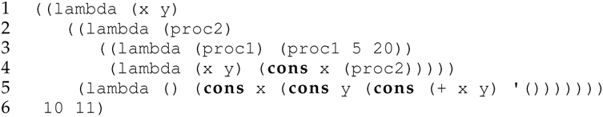
6.10.1 The Downward Funarg Problem
Involves passing a function (called a downward funarg) to another function
The functions passed on lines 4 and 5, and accessed through the parameters proc1 and proc2, respectively, are downward funargs.

Slide 35
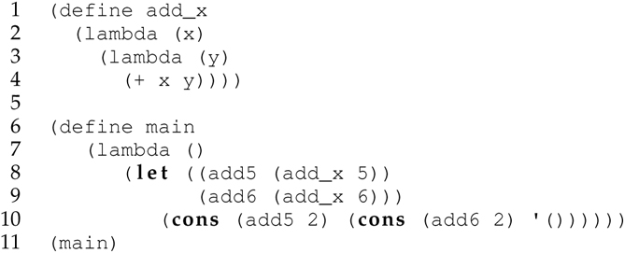
6.10.2 The Upward Funarg Problem (1 of 4)
Involves returning a function (called an upward funarg) from a function, rather than passing functions to a function
Classical example of an upward funarg in Scheme:

Slide 36
6.10.2 The Upward Funarg Problem (2 of 4)
The function add_x returns a closure (lines 3–4), which adds its argument (i.e., y) to the argument to add_x (i.e., x) and returns the result.
The add_x function provides the simplest non-trivial example of a closure. The add_x function creates (and returns) a closure around the inner function.
The returned function contains references to data that no longer exists on the stack.
This is the essence of the funarg problem—how to implement first-class functions in a stack-based language.

Slide 37
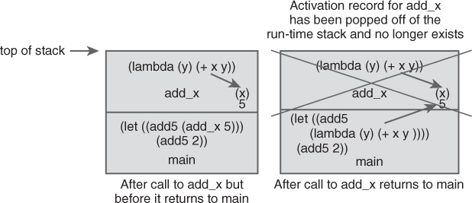
Figure 6.5 Illustration of the Upward Funarg Problem Highlighting a Reference to a Declaration in a Nonexistent Activation Record

Slide 38
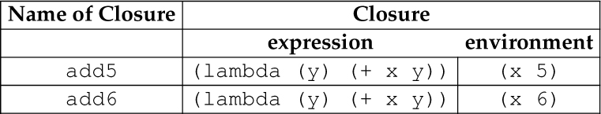
Table 6.6 Example Data Structure Representation of Closures

Slide 39
6.10.2 The Upward Funarg Problem (3 of 4)
Python supports both first-class procedures and first-class closures.
Python rendition of the make adder program
new_counter Scheme function that clones or instantiates counter closures
new_counter function resembles a constructor—it constructs new counters (i.e., objects).
Closures and objects share similarities
Encapsulation of behavior and state
Information hiding
Arbitrary construction at the programmer’s discretion (e.g., new_counter)
Existence of each in a separate memory space

Slide 40
6.10.2 The Upward Funarg Problem (4 of 4)
Python renditions of the new_counter function
Also notice here that we use a named (i.e., def) rather than anonymous (i.e., lambda) function.

Slide 41
6.10.3 Relationship Between Closures and Scope
A closure is a function with free or open variables that are bound to declarations determinable before run-time.
The declarations to which the open variables are bound are closed before run-time (i.e., static scoping) rather than left open until run-time (i.e., dynamic scoping).
Closures—functions with free variables—and combinators—functions without free variables—are opposites of each other.

Slide 42
6.10.4 Uses of Closures
First-class closures are a fundamental primitive in programming languages from which to construct and conceive:
powerful abstractions (e.g., control structures) and
concepts (e.g., parameter-passing mechanisms including as lazy evaluation).

Slide 43
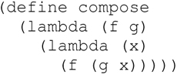
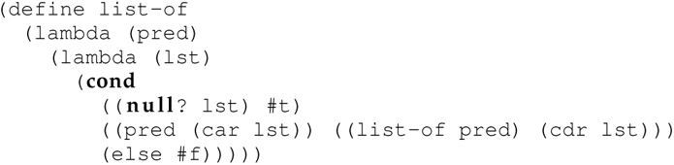
6.10.5 The Upward and Downward Funarg Problem in a Single Function
Some functions accept one or more functions as arguments and return a function as a value.
They involve both downward and upward funarg problems.

Slide 44
6.10.6 Addressing the Funarg Problem
Lambda lifting (λ-lifting) involves converting a closure
i.e., a λ-expression with free variables
into a pure function
i.e., a λ-expression with no free variables
by passing values for those free variables as arguments to the λ-expression containing the free variables itself.
λ-lifting is a simple solution, but it does not work in general.
Another approach: build a closure and pass it to the funarg as a argument when the funarg is invoked

Slide 45
6.11 Deep, Shallow, and Ad Hoc Binding
Deep binding, which uses the environment at the time the passed function was created
Shallow binding, which uses the environment of the expression that invokes the passed function
Ad hoc binding, which uses the environment of the invocation expression in which the procedure is passed as an argument

Slide 46
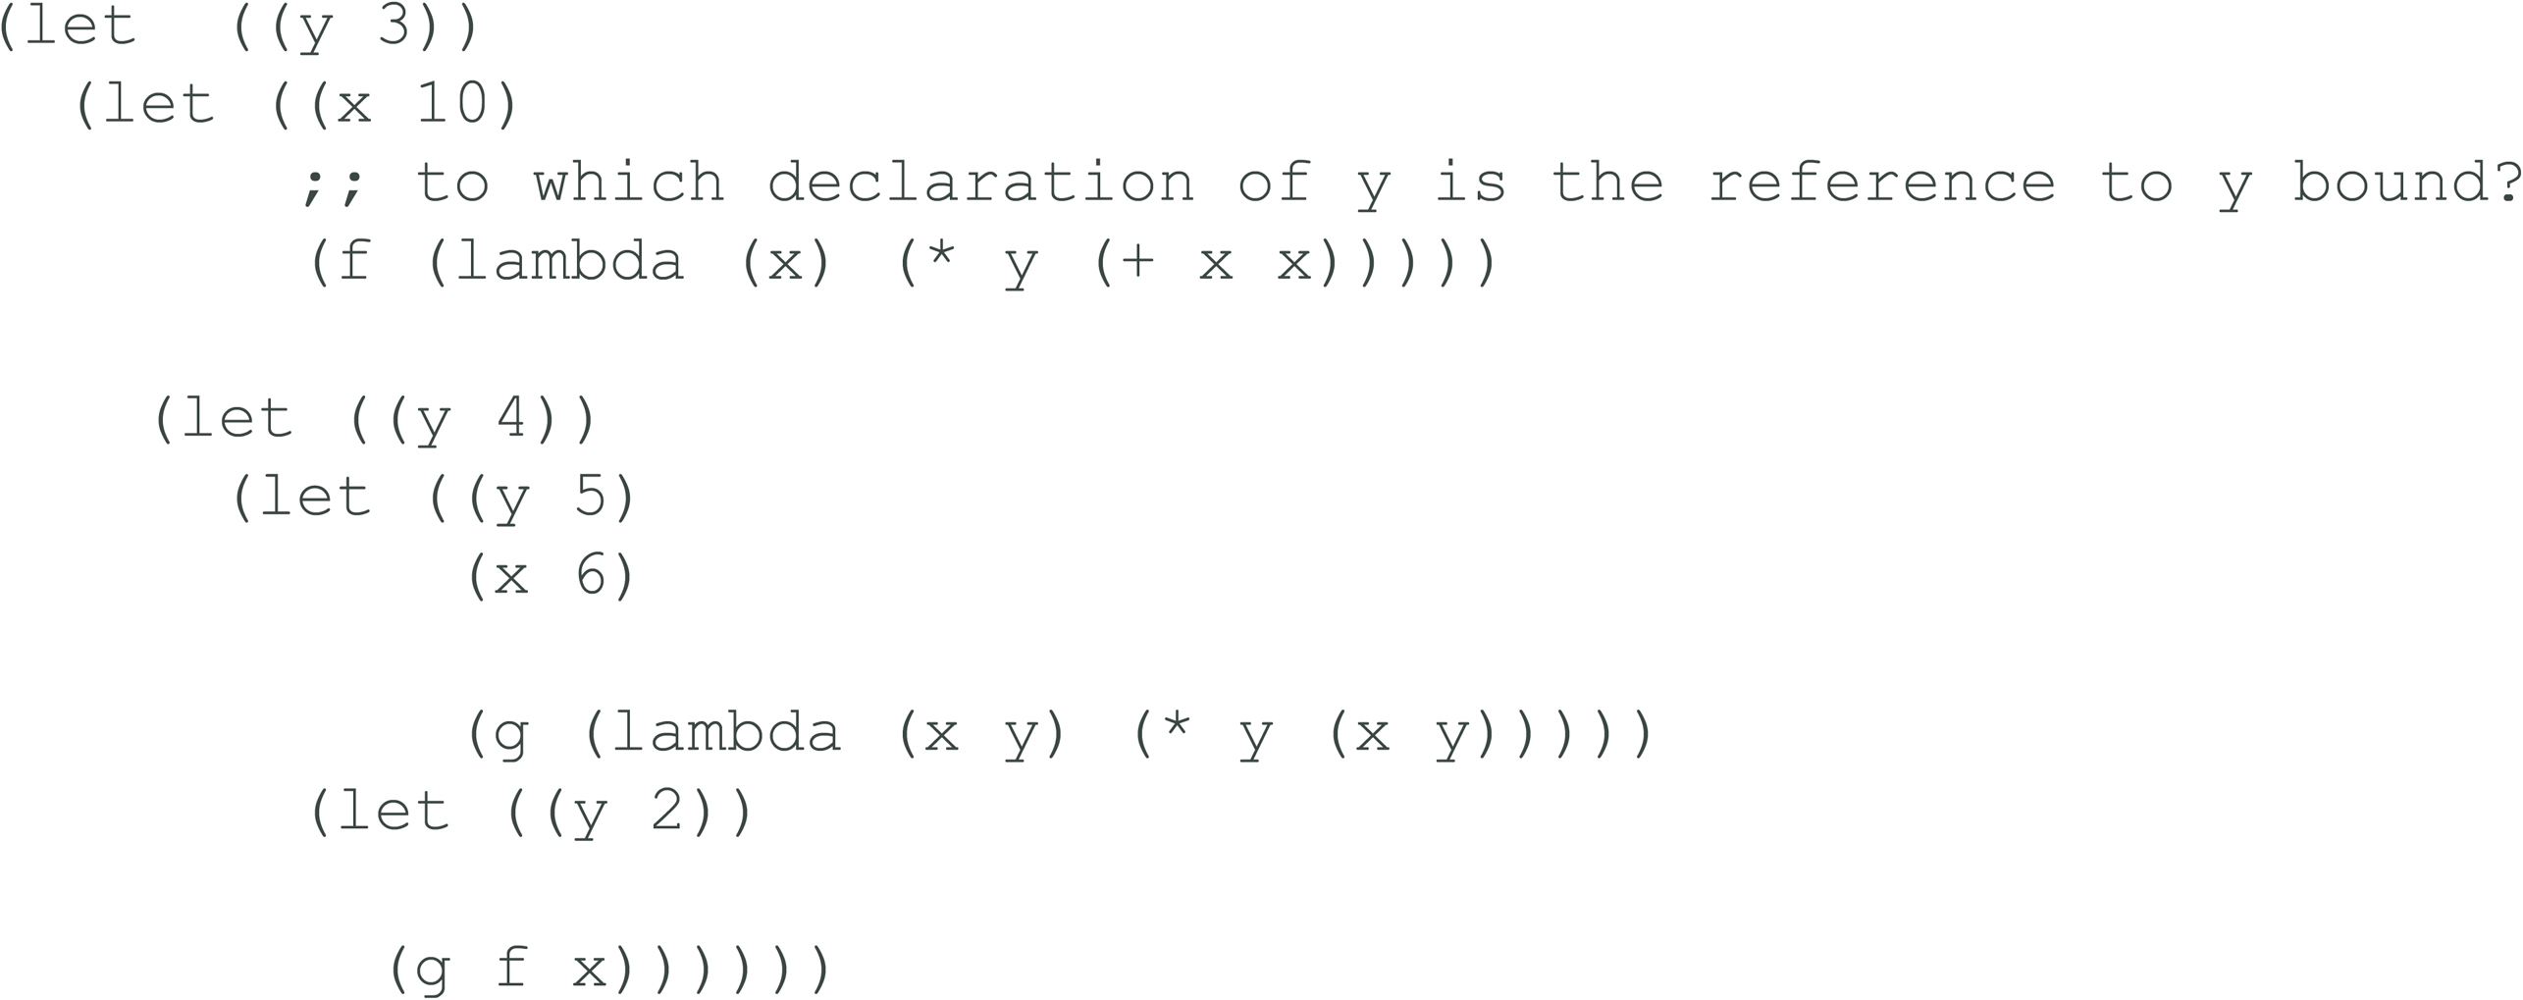
Working Example

Slide 47
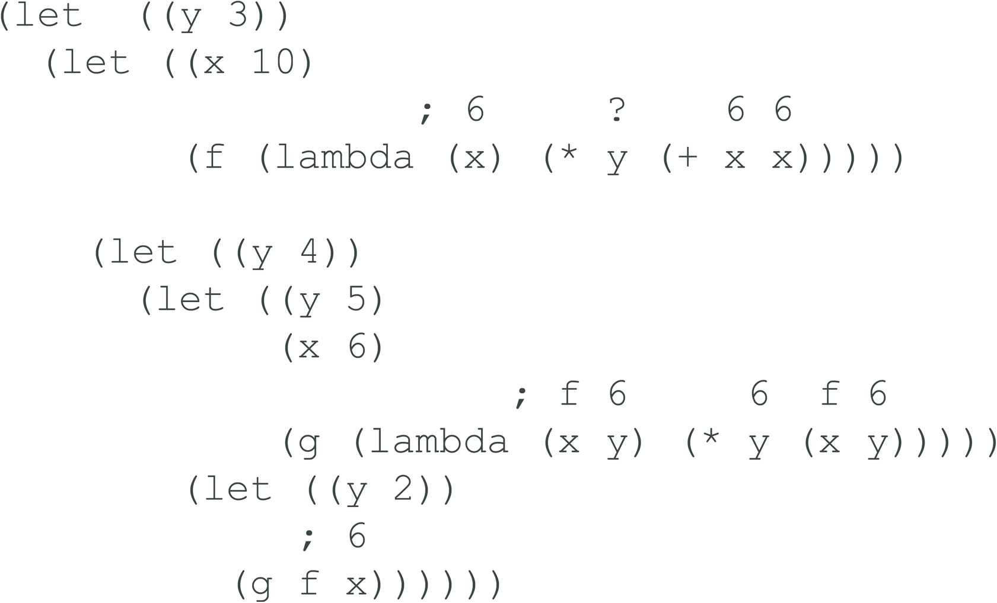
Deep Binding (1 of 4)

Slide 48

Deep Binding (2 of 4)

Slide 49

Deep Binding (3 of 4)

Slide 50

Deep Binding (4 of 4)

Slide 51
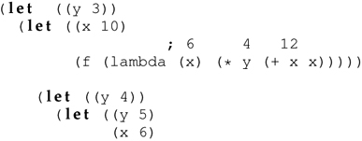
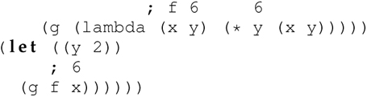
Shallow Binding (1 of 3)

Slide 52

Shallow Binding (2 of 3)

Slide 53
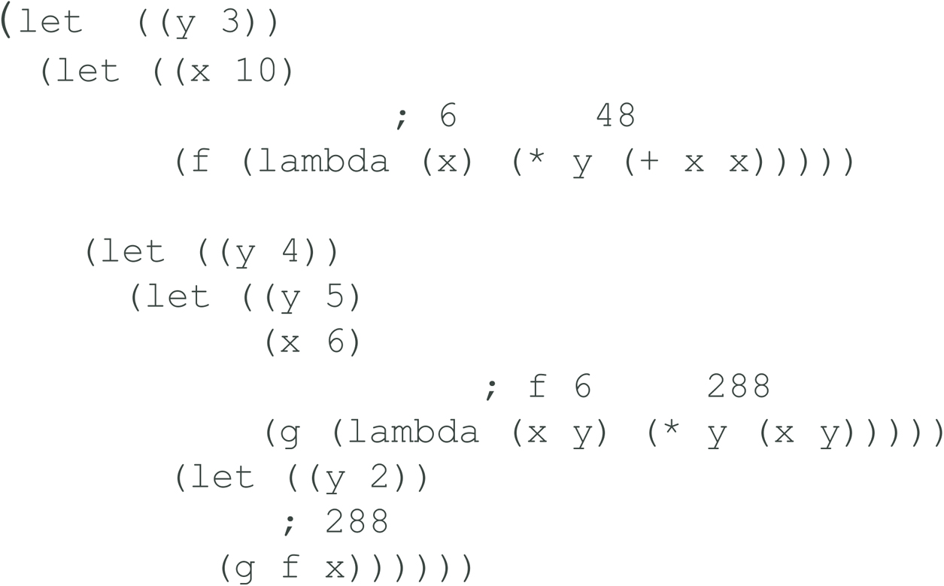
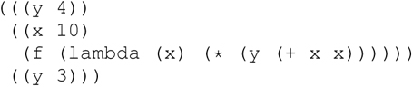
Shallow Binding (3 of 3)
The environment in which the function is called is:

Slide 54
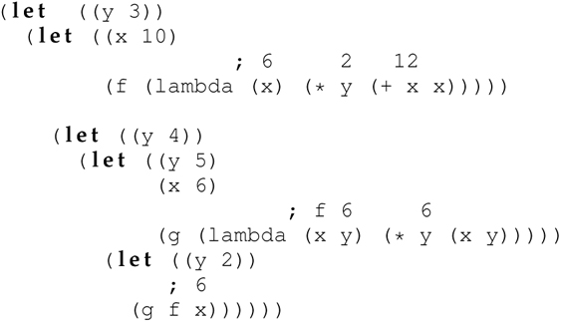
Ad Hoc Binding (1 of 3)

Slide 55

Ad Hoc Binding (2 of 3)

Slide 56
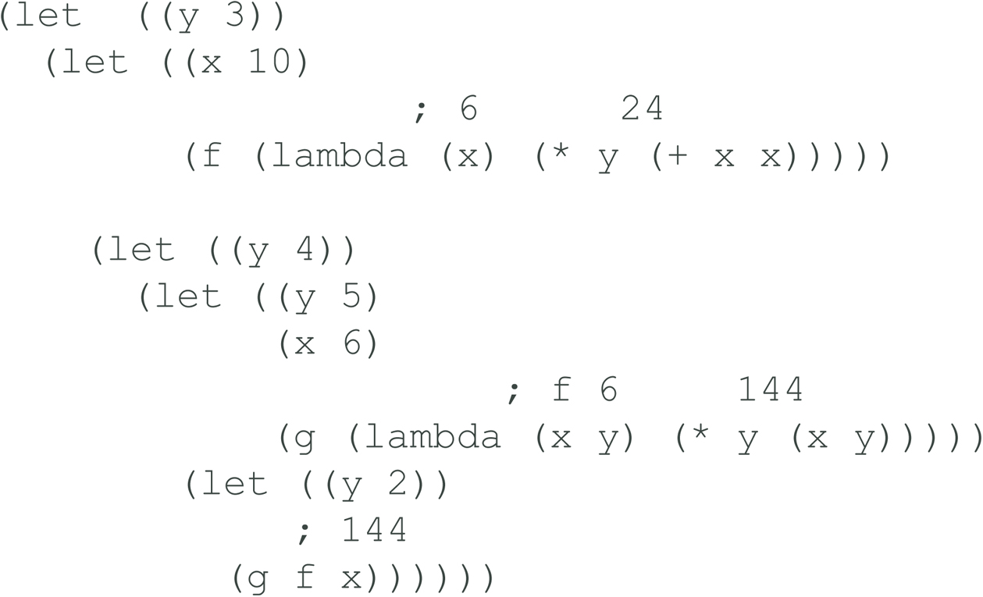
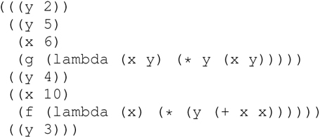
Ad Hoc Binding (3 of 3)
The environment in which the function is called is:

Slide 57
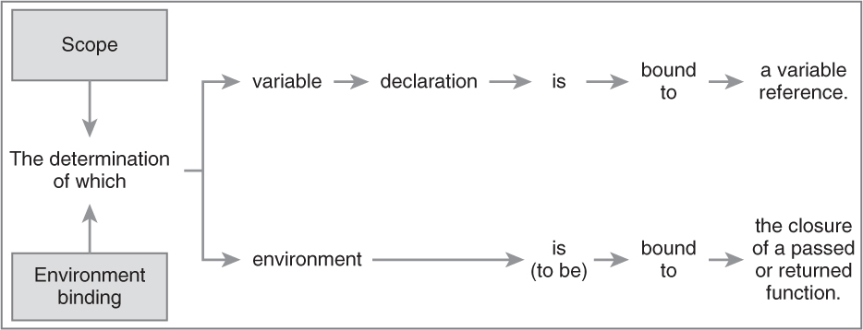
Table 6.7 Scoping Vis-à-Vis Environment Binding

Slide 58
6.12 Thematic Takeaways
Programming language concepts often have options, as with scoping (static or dynamic) and nonlocal reference binding (deep, shallow, or ad hoc).
A closure—a function that remembers the lexical environment in which was created—is an essential element in the study of language concepts.
The concept of binding is a universal and fundamental concept in programming languages. Languages have many different types of bindings; for example, scope refers to the binding of a reference to a declaration.
Determining the scope in a programming language that uses manifest typing is challenging because manifest typing blurs the distinction between a variable declaration and a variable reference.
Lexically scoped identifiers are useful for writing and understanding programs, but are superfluous and unnecessary for evaluating expressions and executing programs.
The resolution of nonlocal references to the declarations to which they are bound is challenging in programming languages with support for first-class functions. These languages must address the funarg problem.

